Slide 1
MP3 Project
Group #3 Zhaoqin Li, Di Li, Arian Velarde

Slide 2
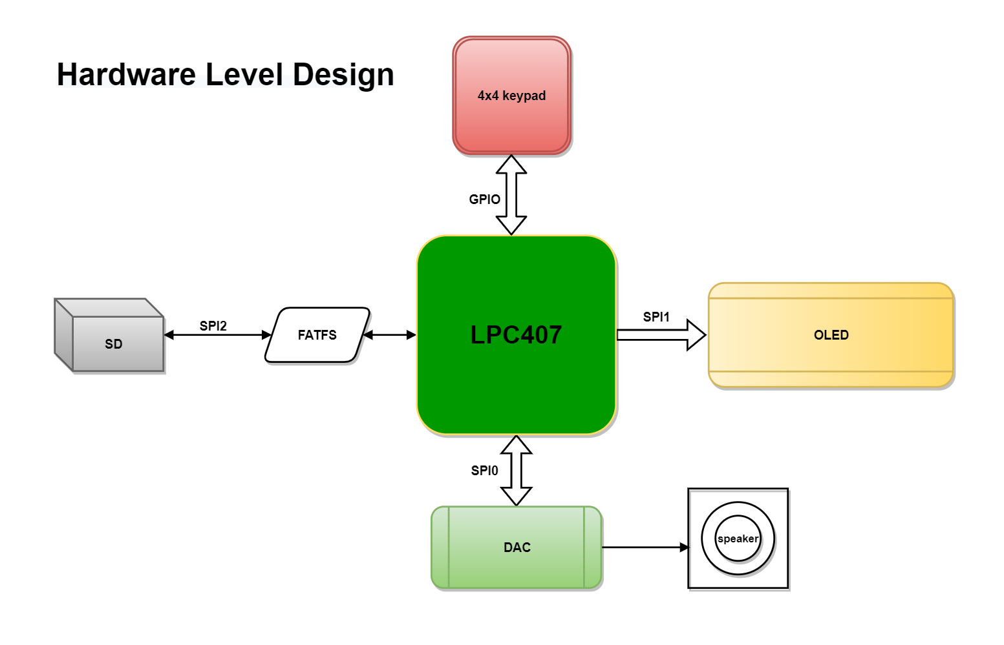

Slide 3
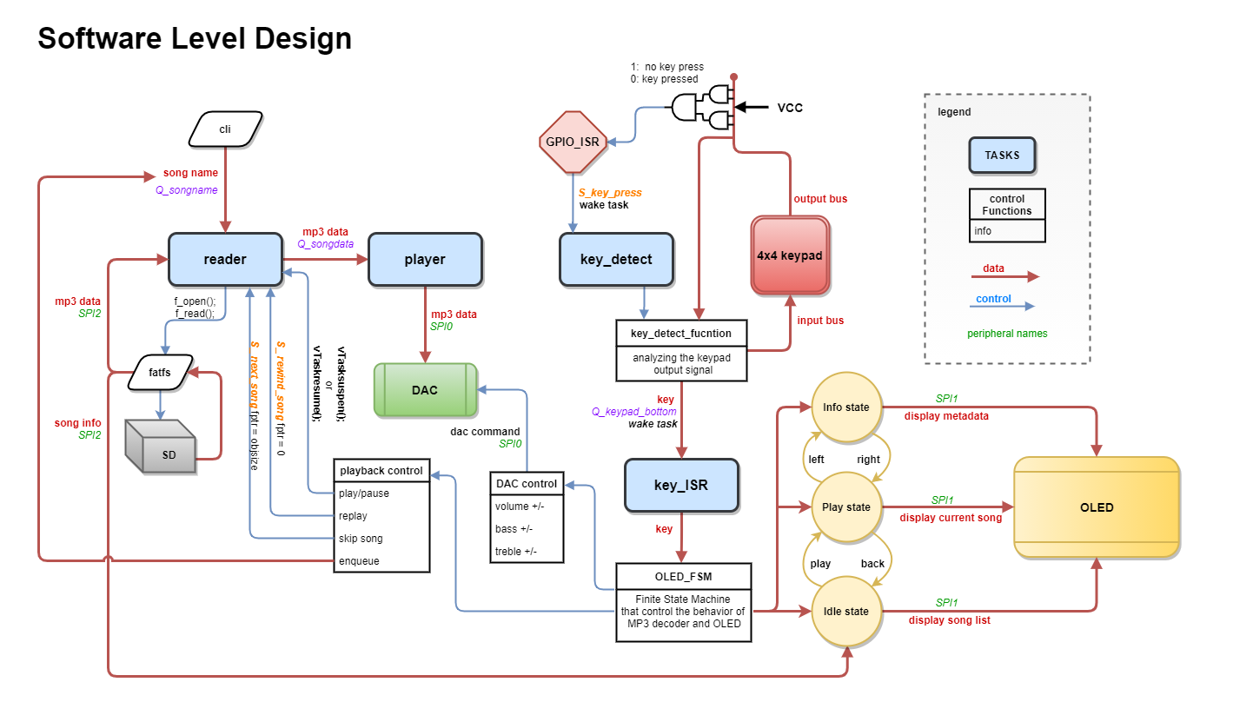

Slide 4
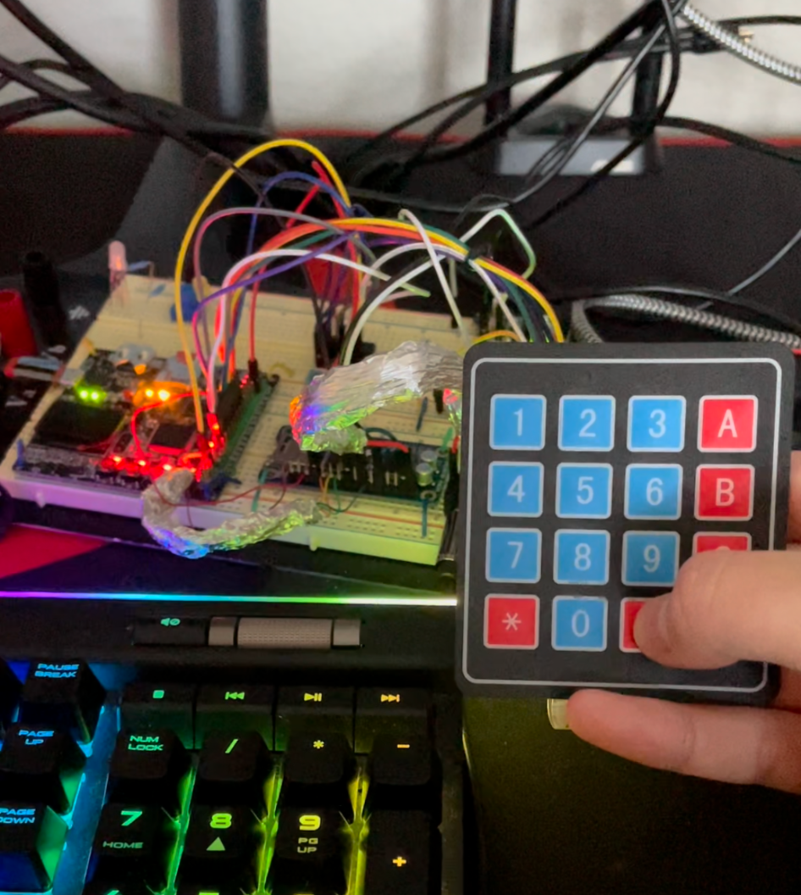
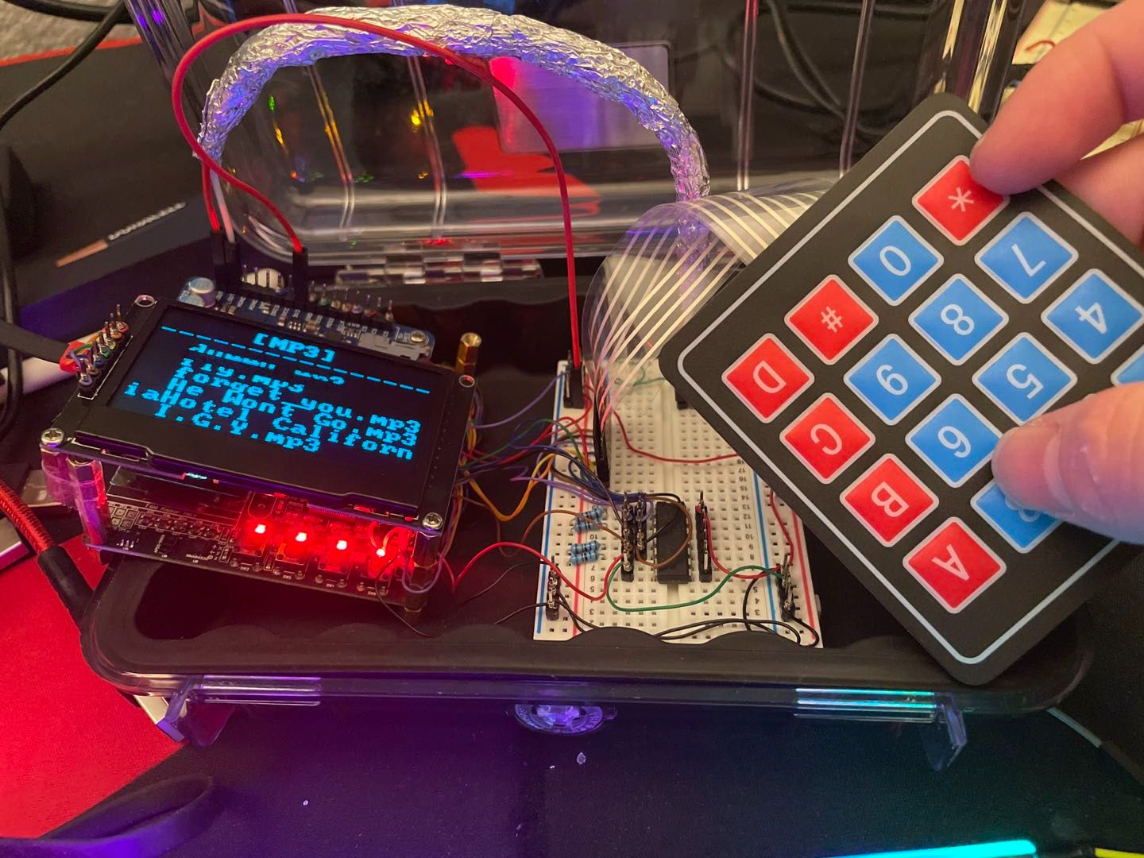
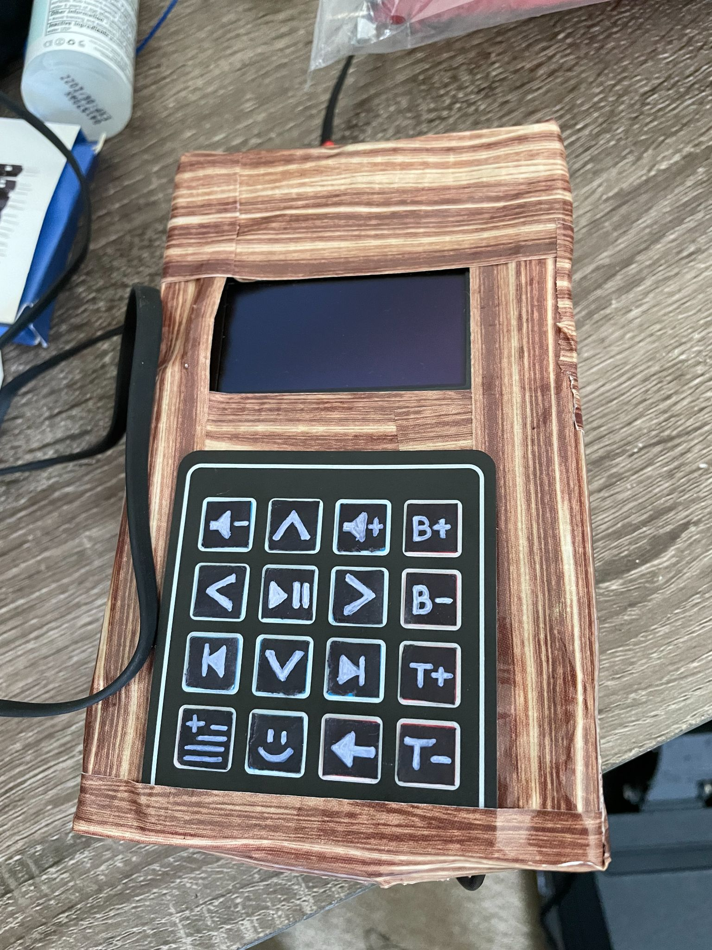
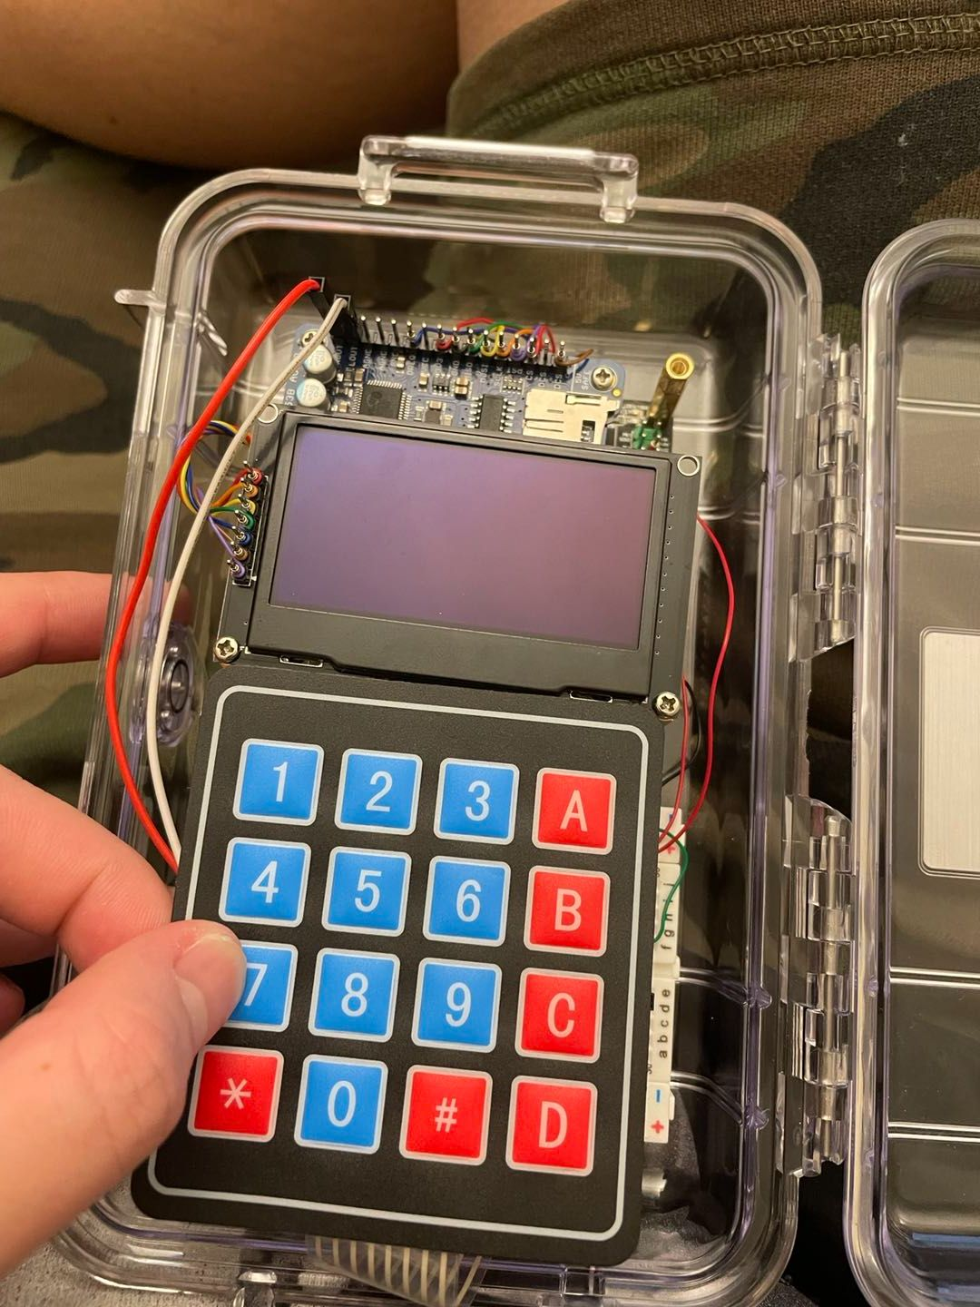
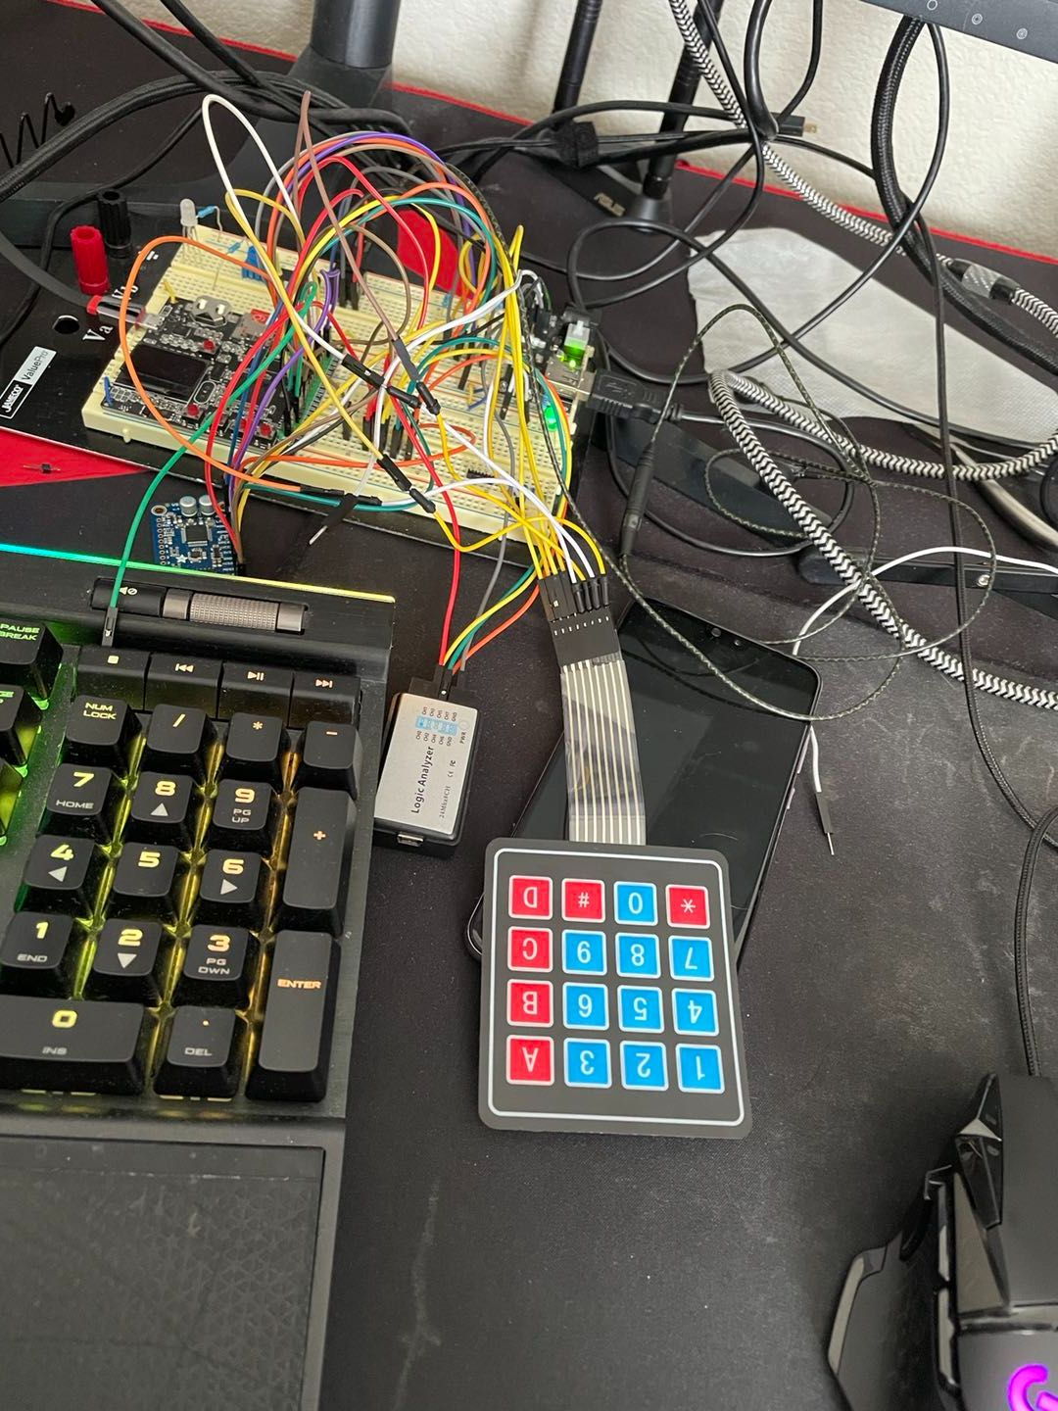
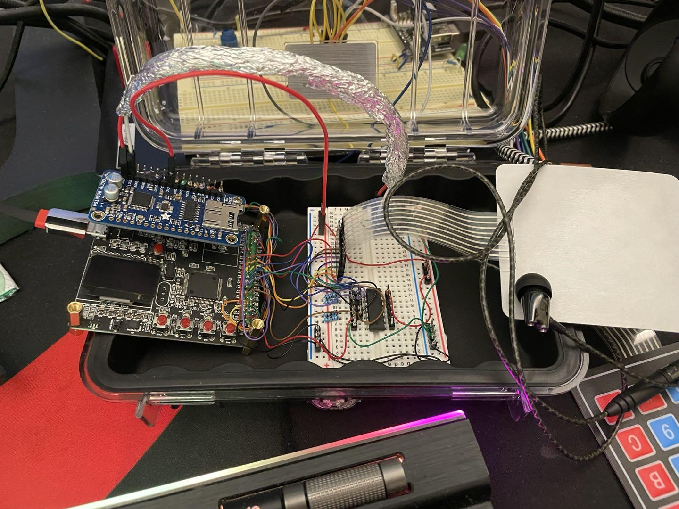
MP3
Assembly
Notes:
In the beginning of the assembly, the wires are hectic. No decoder implemented yet. Keypad driver implemented so that the button press can be recognized
Decoder implemented, keypad function implemented with GPIO interrupt to control the mp3 playback
OLED display functional, moved everything in a clear case
External OLED implemented, rewired connections to stack OLED screen and sj2 board to fit the case
Rewired again to place OLED and keypad orientation from side to side to top and bottom so it looks more similar to an mp3 layout
Final product, due to the lack of resources, we chose styrofoam and duct tape for the final enclosure design because it was the easiest to shape, has lightweight and shock absorption qualities to protect the components and the tape adds extra strength and design appeal to the enclosure, changed the keypad design using stickers from the numbers and letters to mp3 control symbols so that the user can easily navigate through the mp3 functions

Slide 5
MP3 Demo

Slide 6

Thank You
Do you have any question?

